Slide 1
Daily QCDC Report
Check In Status for all ERC and PE Parts including weld data
Pallavi Kulkarni

Slide 2
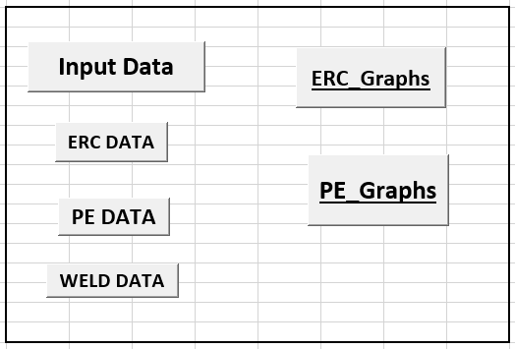
MS Excel Tabs to collect Data and Visualize Data
Input Data : Collect per day wise all Data from server generated csv file.
ERC Data : Collected data filtered as ERC Dept. created Data.
PE Data : Collected data filtered as PE Dept. created Data.
ERC WELD Data : Collected data filtered as ERC Dept. created Weld Data.

Slide 3
Data :
Overall Input Data :
https://github.com/kulkarnipallavi99/QCDC/blob/master/CHECKIN_DATA_STATUS.csv
ERC Data :
https://github.com/kulkarnipallavi99/QCDC/blob/master/ERC%20Data.csv
https://github.com/kulkarnipallavi99/QCDC/blob/master/Projectcode%20wise%20ERC%20Data.csv
PE Data :
https://github.com/kulkarnipallavi99/QCDC/blob/master/PE%20Data.csv
Weld Data :
https://github.com/kulkarnipallavi99/QCDC/blob/master/WELD_ERC_DATA.csv

Slide 4
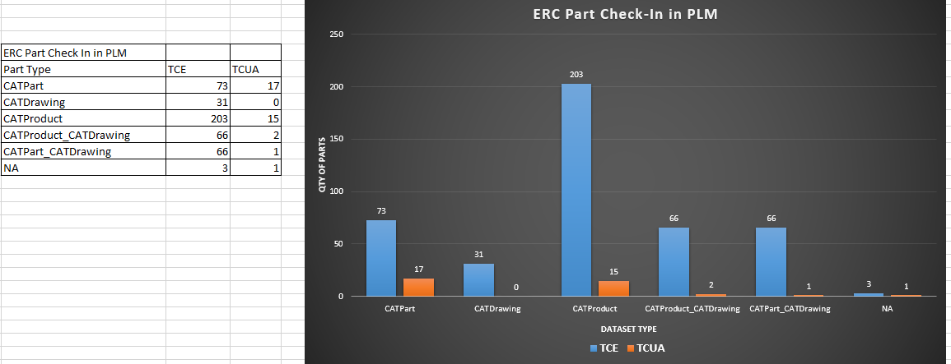
ERC Part check In in PLM:
This Check in Status collected from Total number of Checked in Parts along with its Dataset types.

Slide 5
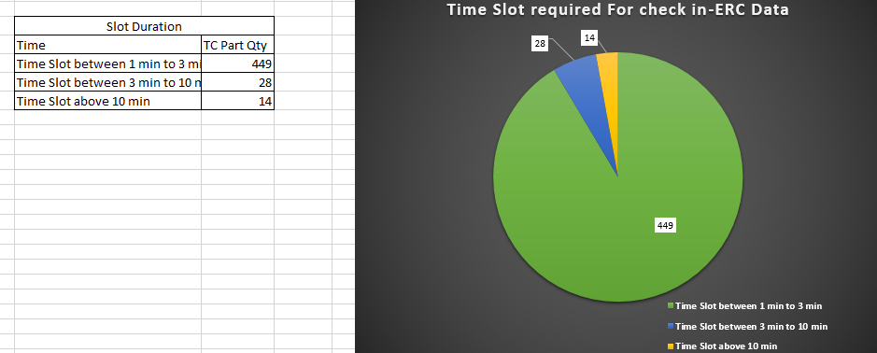
ERC Part check In in PLM:
This Check in Status collected from Time required for Check in Data.

Slide 6
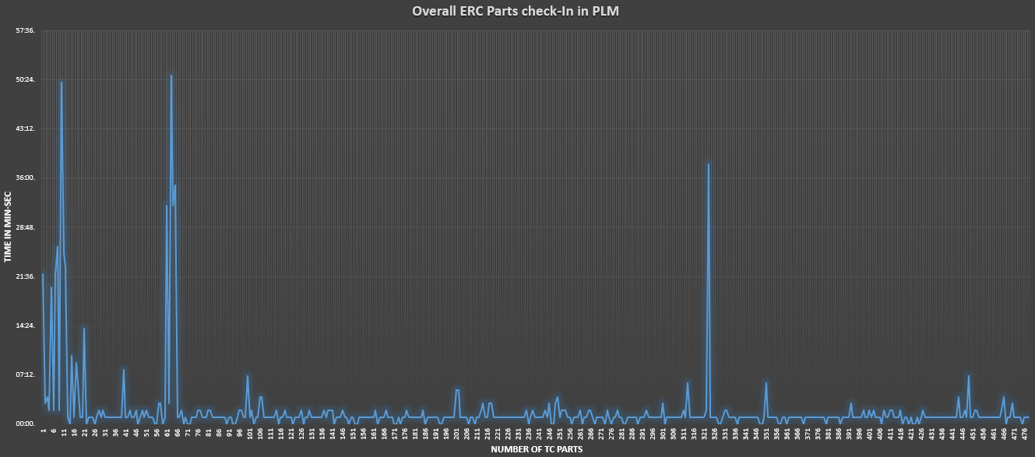
ERC Part check In in PLM:
This Check in Status is collected from Total number of TC Parts and Time required for check in.

Slide 7
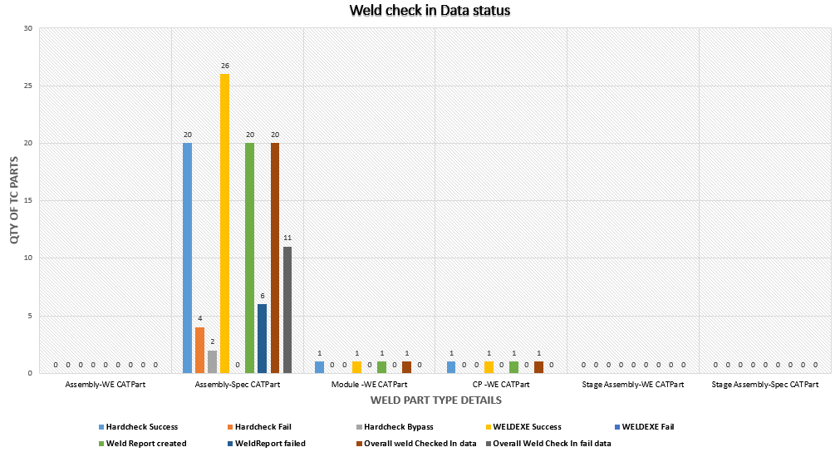
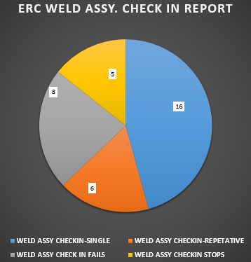
ERC Part check In in PLM:
This weld related graphs represents Exe.s Required to check in Data as well as Overall Status of Data (Pie Chart).

Slide 8
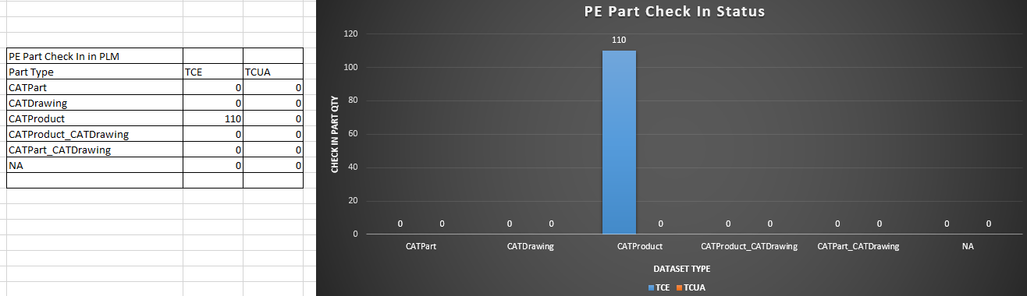
PE Part check In in PLM:
This Check in Status collected from Total number of Checked in Parts along with its Dataset types.

Slide 9
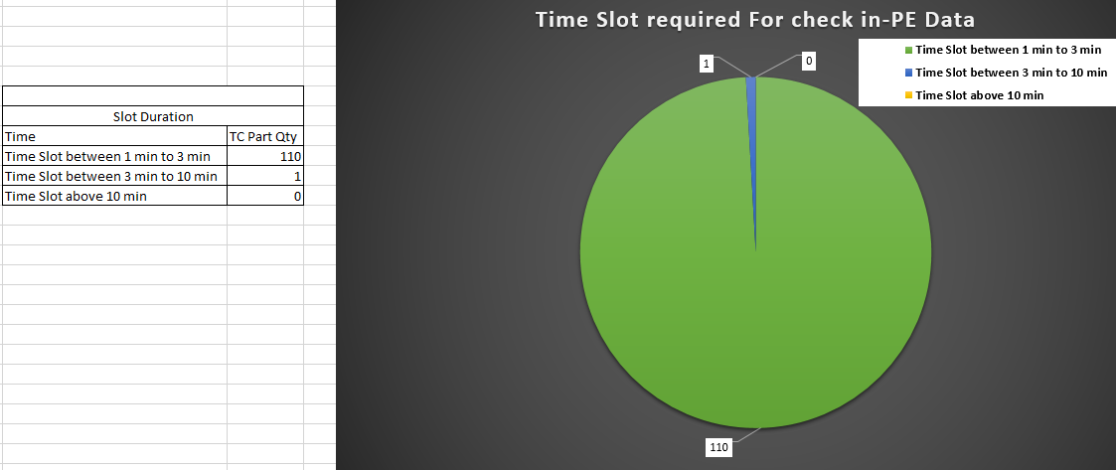
PE Part check In in PLM:
This Check in Status collected from Time required for Check in Data.

Slide 10
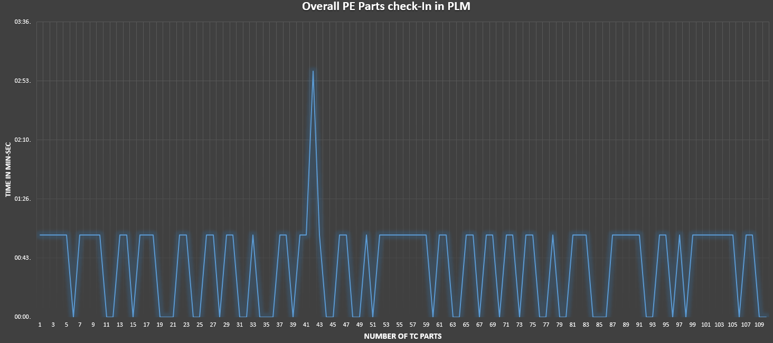
PE Part check In in PLM:
This Check in Status is collected from Total number of TC Parts and Time required for check in.

Slide 11
Daily QCDC Report
Thank You!!

